Slide 1
Presentation on: Blanking and synchronizing pulses PRESENTED TO: MD IMRAN HOSSAIN ASSISTANT PROFESSOR DEPARTMENT OF ICT COMILLA UNIVERSITY PRESENTED BY:
RIFATUN NESA PITU
ID NO:11809006
DEPARTMENT OF ICT
COMILLA UNIVERSITY

Slide 2
Outline 1)Introduction to blanking pulse and synchronizing pulse 2) Horizontal and vertical blanking pulse 3) Synchronizing pulse criteria 4) need for blanking and synchronizing pulses

Slide 3
Introduction Blanking pulse A voltage pulse which is considered as a positive or negative square wave pulse used to switch off a part of television or radar set electronically. Synchronizing pulse A pulse used to achieve or maintain synchronism. synchronism is the fact or state of being synchronous or simultenous occurrence.

Slide 4
the level of the blanking pulses is distinctly above the picture signal information. these are not used as sync pulses. Horizontal blanking pulses at 15,750 Hz blank out the retrace from right to left for each line. Vertical blanking pulses at 60 Hz blank out the retrace from bottom to top for each field.
Horizontal and vertical blanking pulse

Slide 5
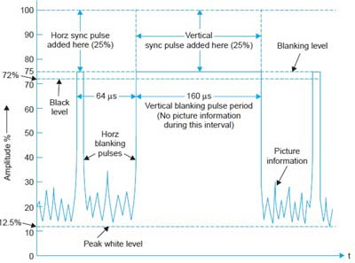
Fig: horizontal and vertical blanking pulses

Slide 6
Synchronizing pulse criteria the synchronizing pulses are transmitted or stored along with the analog video signal for each line. These synchronizing pulses are then used to trigger the receiver's circuitry to make sure that the scene is sequenced properly on the screen.

Slide 7
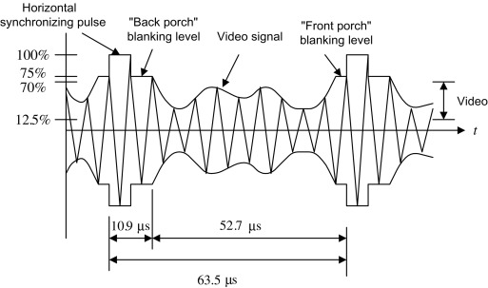
Fig: synchronizing pulse

Slide 8
need for blanking and synchronizing pulses The purpose of the blanking pulses is to make invisible the re-traces required in scanning. Synchronizing pulses help to keep the receiver and transmitter in step with one another.

Slide 9
Thank you all

